Slide 1
An Enhanced Framework for Analyzing and Visualizing Task Scheduling Alogrithms for Real
Time Operating System
First Review
Team Members:
Joel Ananth A (2021503022)
Karthi M (2021503514)
Sree Vaasini S (2021503562)
Sree Varshini S (2021503563)

Slide 2
Outline
Objective
Workflow
Languages and Tools Used
Implementation Details
References

Slide 3
Objective
To design a framework for an efficient task scheduling algorithm in real time operating system.
To enhance performance metrics such as deadline miss rate, average response time, CPU utilization, fairness, throughput, overhead, resource usage.
The main job of our research is to identify scope for enhancing few metrics like throughput time, starvation time, overhead, response time, etc., and propose a new algorithm to address the same.

Slide 4
LITERATURE SURVEY
PAPER | TOPIC | PROPOSED ALGORITHM | PERFORMANCE METRICS | COMPARISON
Zouaoui et al. (2019) | CPU scheduling | Priority based Round Robin (PBRR) | Deadline miss rate, average response time | Standard Round Robin, FCFS, SJF, PS
Chaaban (2023) | Real-time scheduling and resource mapping for ROS | Priority-based approach | Deadline miss rate, average response time, throughput | Other existing scheduling algorithms for ROS
Malallah et al. (2021) | Kernel concepts in different operating systems | - | - | -

Slide 5
PAPER | TOPIC | PROPOSED ALGORITHM | PERFORMANCE METRICS | COMPARISON
Rinku et al. (2022) | Scheduling techniques for RTOS | RMS, EDF, PIP | - | Advantages and disadvantages of each technique
Zagan and Găitan (2020) | Real-time event handling and preemptive hardware RTOS scheduling | Preemptive scheduling approach | - | Simulation
Donga and Holia (2020) | Scheduling algorithms in RTOS | Round Robin, Priority Scheduling, EDF, RMS | - | Advantages and disadvantages of each algorithm
Kabilesh et al. (2020) | Real-time scheduling algorithms for embedded systems | Round Robin, Priority Scheduling, EDF | Response time, deadline miss rate, CPU utilization | Advantages and disadvantages of each algorithm

Slide 6
PAPER | TOPIC | PROPOSED ALGORITHM | PERFORMANCE METRICS | COMPARISON
Akram et al. (2019) | Task allocation algorithm for real-time partitioned scheduling on multi-core systems | Partitioned scheduling approach | Throughput, fairness | Other existing task allocation algorithms
Sharma et al. (2021) | Priority-based joint EDF-RM scheduling algorithm for individual real-time tasks on distributed systems | Combination of EDF and RM | Average response time, deadline miss rate, processor utilization | Existing algorithm
Yu and Lu (2023) | Improved task scheduling algorithm for embedded RTOS | Priority-based method | Average response time, deadline miss rate, CPU utilization | Existing algorithms

Slide 7
PAPER | TOPIC | PROPOSED ALGORITHM | PERFORMANCE METRICS | COMPARISON
Harkut and Ali (2016) | Adaptive task scheduler for RTOS implemented in hardware | Priority-based approach | Scheduling latency, throughput | Software-based schedulers

Slide 8
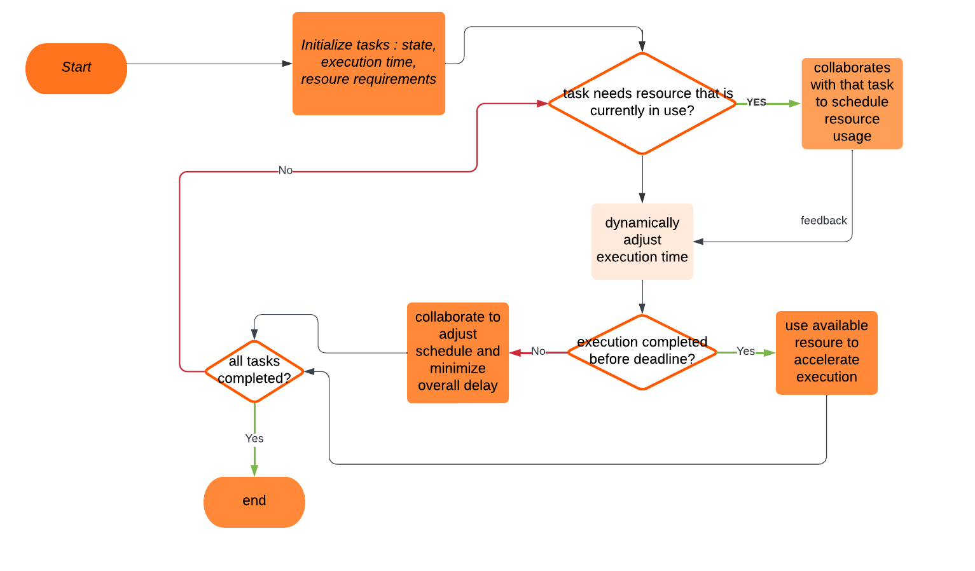
WorkFlow of Collaborative Task Scheduling

Slide 9
Languages and Tools to be Used
Open source softwares like OpenGL
Hosting services tools - Amazon Web Services
Languages - Python, CPP, JavaScript

Slide 10
Implementation Details
Module 1 - Implementation of collaborative task scheduling, with the following components
1.1 Task profiling
1.2 Resource allocation
1.3 Dynamic scheduling
1.4 Priority-based scheduling
1.5 preemption
1.6 Task migration
Module 2 - Develop an application for analyzing the implemented algorithm for its efficiency against metrics mentioned

Slide 11
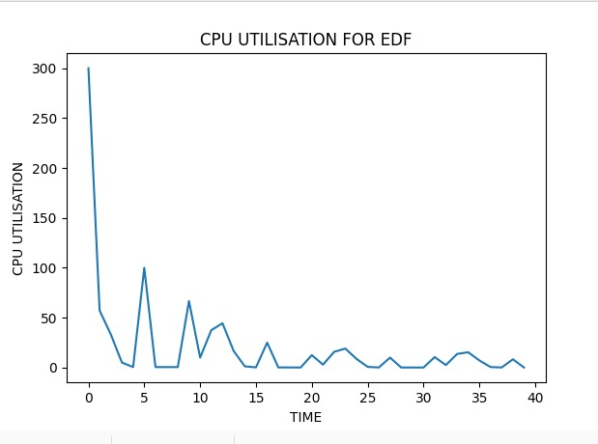

Slide 12
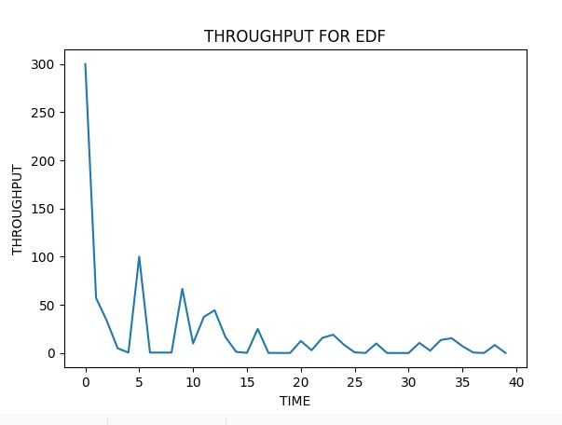

Slide 13
Similarly, graphs for tracking the same metrics, namely, throughput, cpu utilisation and deadline miss rate, for other exising algorithms(LSTF,RMS and FCFS) have been generated.

Slide 14
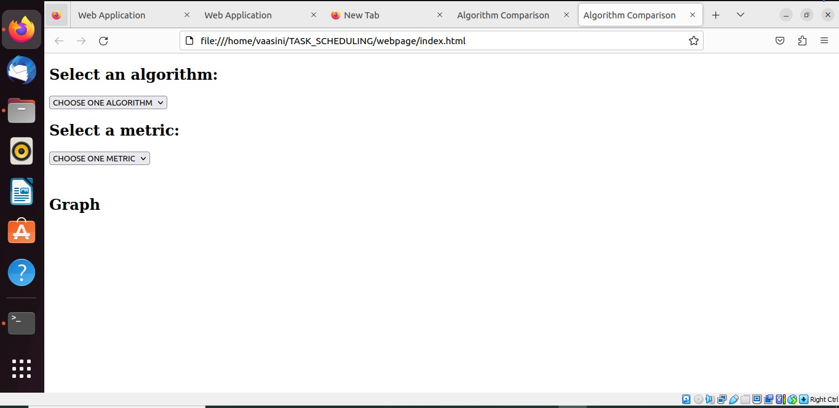

Slide 15
Implementation Details - Performance Analysis Metrics
Following metrics have been chosen for comparison of Collaborative Task Scheduling
Deadline miss rate
Average response time
CPU utilization
Fairness
Throughput
Overhead
Resource usage

Slide 16
References
Zouaoui, S., Boussaid, L. and Mtibaa, A., 2019. Priority based round robin (PBRR) CPU scheduling algorithm. International Journal of Electrical & Computer Engineering (2088- 8708), 9(1).
Chaaban, K., 2023. A New Algorithm for Real-Time Scheduling and Resource Mapping for Robot Operating Systems (ROS). Applied Sciences, 13(3), p.1532.
Malallah, H., Zeebaree, S.R., Zebari, R.R., Sadeeq, M.A., Ageed, Z.S., Ibrahim, I.M., Yasin,H.M. and Merceedi, K.J., 2021. A comprehensive study of kernel (issues and concepts) in different operating systems. Asian Journal of Research in Computer Science, 8(3), pp.16-31.
Rinku, D.R., Asha Rani, M. and Suhruth Krishna, Y., 2022. Exploring the Scheduling Techniques for the RTOS. In ICT Infrastructure and Computing: Proceedings of ICT4SD 2022 (pp. 11-18).
Zagan, I. and Găitan, V.G., 2020. Real-Time Event Handling and Preemptive Hardware RTOS Scheduling on a Custom CPU Implementation. Canadian Journal of Electrical and Computer Engineering, 43(4), pp.364-373.
Donga, J. and Holia, M.S., 2020. An analysis of scheduling algorithms in real-time operating system. In Inventive Computation Technologies 4 (pp. 374-381) Springer International Publishing.

Slide 17
7. Kabilesh, S.K., Stephensagayaraj, A., Anandkumar, A., Dinakaran, K., Mani, T. and Gokulnath, S.,2020. Resemblance of Real Time Scheduling Algorithms for Real Time Embedded Systems Journal of Optoelectronics and Communication, 2(3).
8. Akram N, Zhang Y, Ali S, Amjad HM (2019) Efficient task allocation for real-time partitioned scheduling on multi-core systems. In: 16th International Bhurban Conference on Applied Sciences and Technology (IBCAST), pp 492–499 IEEE.
9. Sharma, R., Nitin, N., AlShehri, M.A.R. and Dahiya, D., 2021. Priority-based joint EDF–RM scheduli algorithm for individual real-time task on distributed systems. The Journal of Supercomputing, 77, pp.890-908.
10. Yu, J. and Lu, X., 2023, January. Improvement and Application of Task Scheduling Algorithm for Embedded Real-Time Operating System. In Proceedings of the World Conference on Intelligent and 3-D Technologies (WCI3DT 2022) Methods, Algorithms and Applications (pp. 621-628) Singapore: Springer Nature Singapore.
11. Harkut, D.G. and Ali, M.S., 2016. Hardware support for adaptive task scheduler in RTOS. In Intelligent Systems Technologies and Applications: Volume 1 (pp. 227-245) Springer International Publishing.

